Slide 1
The Parallelization of Membrane Computers to Find Near Optimal Solutions to Cost-Based Abduction
Curry I. Guinn¹
William J. Shipman¹
Ed Addison²
¹University of North Carolina Wilmington
²Lexxle, Inc.

Slide 2
Talk Outline
What is membrane computing?
What is cost-based abduction (CBA)?
How does one model CBA on a membrane computer?
What are some experimental results?
What are some open questions?

Slide 3
What is Membrane Computing?
Biologically-inspired branch of natural computing
Abstracting computing models from the structure and functioning of living cells and from the organization of cells in tissues or other higher order structures
The basic elements of a membrane system are the membrane structure and the sets of evolution rules which process multisets of objects placed in the compartments of the membrane architecture
  Also known as a P-System after Gheorghe Păun.

Slide 4
How are membranes composed?
A membrane structure is a hierarchically arranged set of membranes.
Objects within membranes evolve through a set of rules which may combine objects, mutate objects, delete objects, or pass objects through membranes.
Rules potentially can change membrane structures themselves (dissolving, dividing or creating membranes).
Object selection and rule selection is a non-deterministic process.
Certain classes of membrane architectures have been shown to be equivalent to Turing Machines and thus are capable of any computation

Slide 5
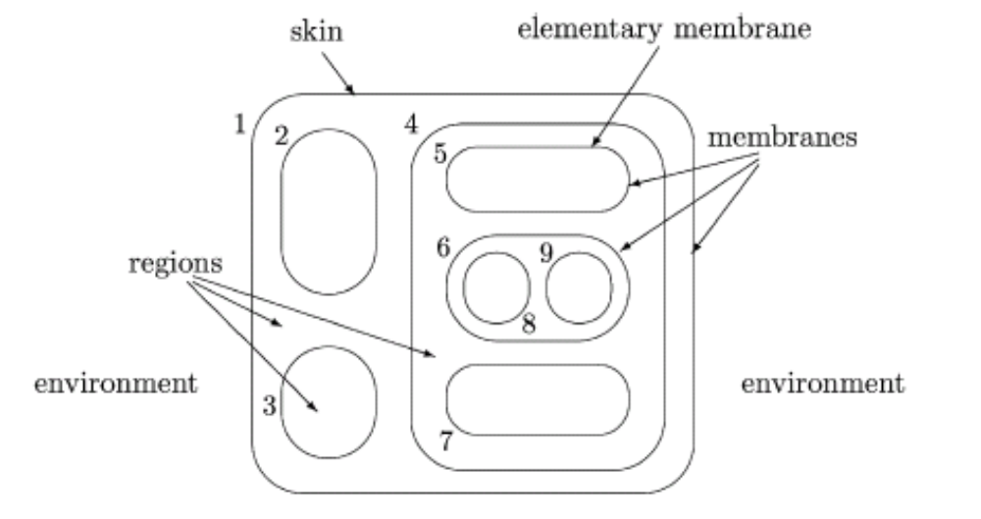
The Hierarchical Structure of Membranes

Slide 6
What is Cost-Based Abduction (CBA)?
An attempt to find a proof with the lowest cost
Reasoning under uncertainty
NP-Hard

Slide 7
Cost-based Abduction (CBA)
Abduction is the process of proceeding from data describing observations or events, to a set of hypotheses, which best explains or accounts for the data.
Employed in a variety of application domains including medical diagnostics, natural language processing, belief revision, and automated planning.
Cost-based abduction is a formalism in which
  Evidence to be explained is treated as a goal to be proven,
  Proofs have costs based on how much needs to be assumed to complete the proof, and
  The set of assumptions needed to complete the least-cost proof are taken as the best explanation for the given evidence.

Slide 8
CBA, Formally Defined
A CBA system is a knowledge representation in which a given world situation is modeled as a 4-tuple K = (H,R, c, G), where
  H is a set of hypotheses or propositions,
  R is a set of rules of the form
    (h_{i1} ^ h_{i2} ^ : : : ^ h_{in}) → h_{ik} ,
    where h_{i1} ; : : : ; h_{in} (called the antecedents) and h_{ik} (called the consequent) are all members of H,
  c is a function c : H → ℜ+, where c(h) is called the assumability cost of hypothesis h ∈ H and ℜ+ denotes the positive reals,
  G ⊆ H is called the goal set or the evidence.

Slide 9
CBA, An Informal Example
    (A ∧ B) → G
    (C ∧ D) → G
    (E ∧ F) → C
    A: 50
    B: 100
    C: ∞
    D: 10
    E: 30
    F: 90
What’s the lowest cost proof?

Slide 10
Representing a CBA Solution As A String
A possible solution to a CBA problem may be represented as a string with each character (or bit) of the string indicating whether a particular hypothesis is true or false.
As an example, a 6-bit string 101110 would indicate
  the hypotheses 1, 3, 4, and 5 are assumed
  while hypotheses 2 and 6 are not.
  The cost of the solution is then the sum of the cost of hypotheses 1, 3, 4, and 5.

Slide 11
Not All Strings Are Solutions; How Can We Fix Them?
A repair technique based on a type of stochastic local search.
If the hypotheses (represented by the string x) assumed are sufficient to prove the goal, then the fitness of the solution is made equal to the assumability cost of the hypotheses corresponding to the 1-bits of x and no further processing is needed.
Otherwise, we randomly choose a 0-bit in the x vector and assign it to 1. If the goal still cannot be proven, then we randomly choose another 0-bit and assign it to 1, until the goal is provable.
Repeat as necessary until the modified x is sufficient to prove the goal.

Slide 12
Retracting unnecessary assumptions
This process can of course result in many unnecessary hypotheses being assumed.
We, therefore, follow up this process with a simple 1-OPT optimization process.
We examine each of the 1-bits of the x vector: one by one and in a random order, each 1-bit is assigned to 0 and if the goal can still be proven, then it is retained as 0, otherwise it is set back to 1.

Slide 13
CBA inside of a Membrane
General idea
  Generate some random hypotheses
  Repair them
  Throw away bad hypothesis
  Keep good hypotheses
  Breed good hypotheses
    Evolutionary algorithm

Slide 14
Repair Membranes
Each possible solution to the CBA problem is represented as a string with each bit of the string representing whether a particular hypothesis is assumed to be true or false.
Candidate solutions are placed in an inner (Repair) membrane.
To pass to the parent membrane, solutions must be repaired so that they actual prove the goal.

Slide 15
Breeding Membranes
Delete Rule: Grab a number of strings within the membrane (in our implementation that number is 7), determine the cost of each hypothesis and delete the lowest.
Crossing Rule: Grab a number of strings (3, for instance) and choose the one with the best score. Grab another 3 strings and choose the best. Do a point-wise cross of the two strings at a random point creating two children. Pass the children to the Repair sub-membrane.
Ascend Rule: Grab a number of strings (6), choose the one with the best score, and pass to parent membrane.

Slide 16
Breeding Membranes Can Be Arranged Hierarchically
Each membrane potentially could reach a local minima and obtain no further improvement.
One enhancement to the model is to allow parent membranes to occasionally pass down one of its best solutions to a child.
This feedback would then cause the child to splice its best solution with this new solution, starting a new cycle of splices and repairs.
Feedback Rule: Grab a number of hypotheses in the membrane (we chose 7), pick the best and send to a randomly chosen child membrane.

Slide 17
10011011 100011
110011
111100
GrandParent
Delete Rule
10011011 110011
111001 101010
111100 001101
111110
Child
Child
Ascend Rule
Ascend Rule
10011011 100011
110011
111100
10011011 100011
110011
111100
Repair
Crossing Rule
Repair
Crossing Rule
10011011
101011011
Crossing Rule
Feedback Rule
Splice
10011011 100011
110011
111100
Repair
Feedback Rule
Repair
Child
10011011 100011
110011
111100
Child
10011011 100011
110011
111100
Ascend Rule
Ascend Rule
10011011 100011
110011
111100
10011011 100011
110011
111100
Repair
Crossing Rule
Repair
Crossing Rule
10011011
Parent
Parent
Repair
Crossing Rule
Ascend Rule
10011011
Outer Skin

Slide 18
Lexxle’s ABC System
Our implementation of the membrane computer is accomplished using the Lexxle P-System/ABC System Toolkit by Lexxle, Inc. developed specifically for use on cluster computers.
Design and testing of the architecture is accomplished using a graphical user interface supported by the GridNexus software developed at the University of North Carolina Wilmington.

Slide 19
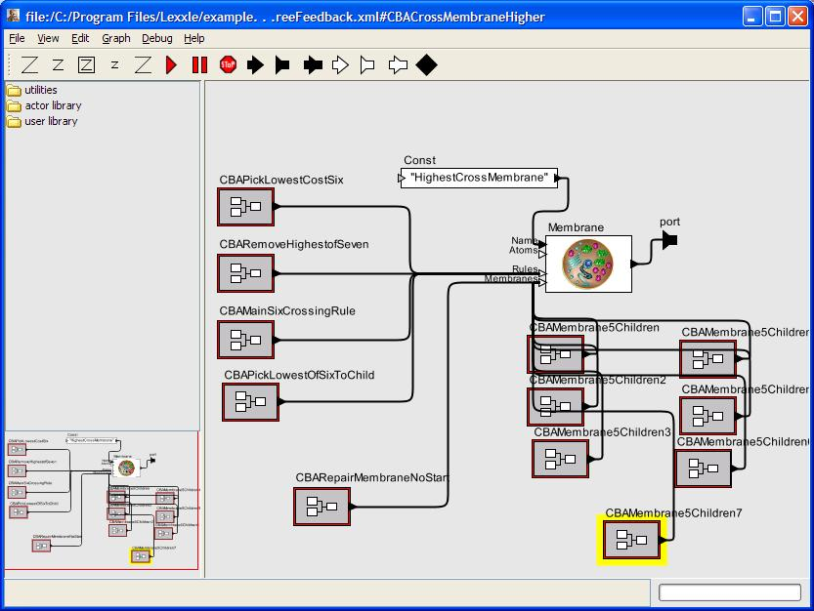
A Screenshot of Lexxle’s ABC System Interface

Slide 20
The CBA Problem Set
Instance | raa180
No. of hypotheses | 300
No. of rules | 900
No. of Assumable hypotheses | 180
Rule depth | max: 38, avg: 25.0 median: 27
Optimal solution cost | 10,821
ILP CPU time (sec) | 88,835
Standard collection found at www.cbalib.org created by Ashraf Abdelbar.

Slide 21
Experimental Results
Some previous results
  Iterated local search (ILS)
  Repetitive simulated annealing (RSA), and
  A hybrid two-stage approach combining these two methods (ILS-RSA)
  Hierarchical particle swarm optimization technique (HPSO)
  Evolutionary algorithm (EA)

Slide 22
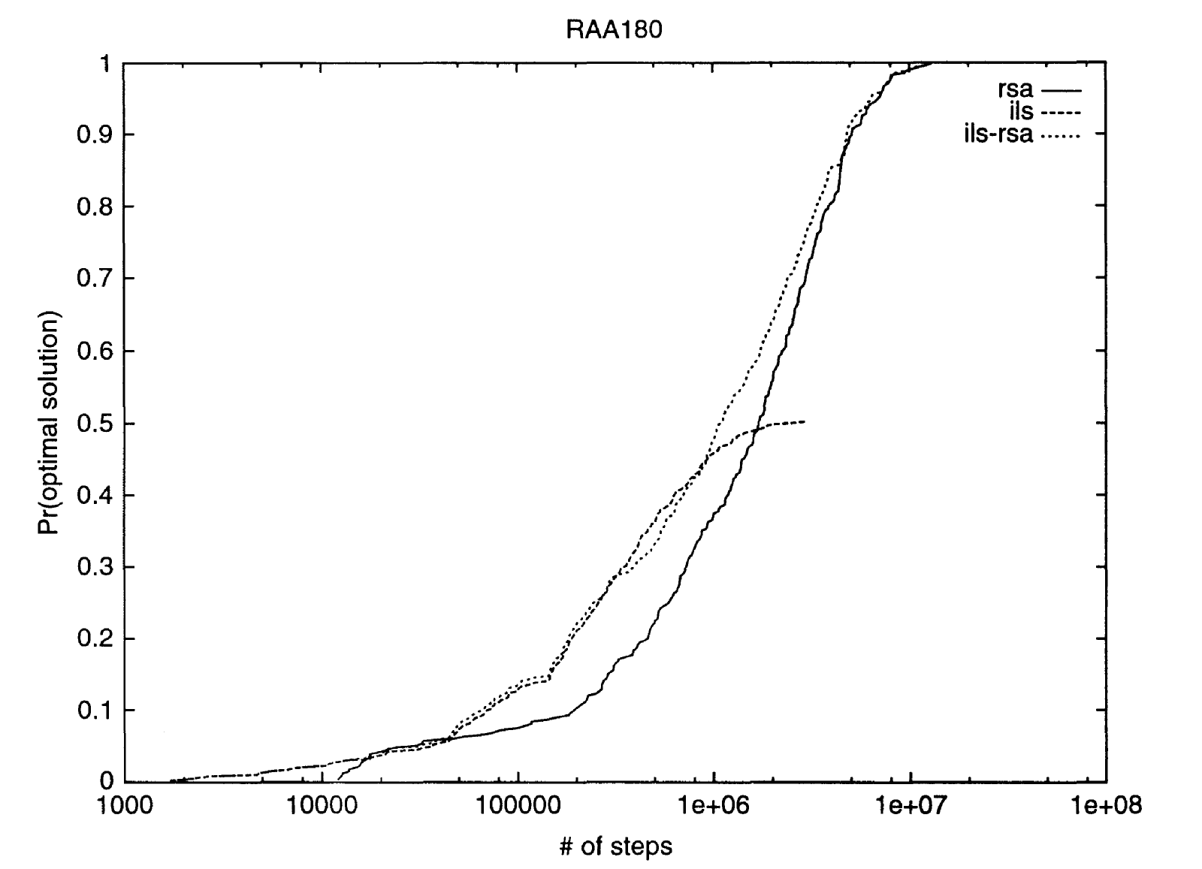
ILS, RSA, and ILS-RSA
Abdelbar (2006)

Slide 23
HPSO and EA
Chivers et al. (2007) use a hierarchical particle swarm optimization technique (HPSO)
A mean score of 12,155 (89% of optimal) for raa180. The minimum score found out of 3,584 trials was 11,381 (95% of optimal).
Chivers et al. (2007): An evolutionary algorithm (EA) which uses point-wise splicing as our method does.
Best results were reported with an initial population size of 100 with 1000 iterations for each trial.
The average solution was 11,574 (93.5% of optimal) with the best solution out of 543 trials being 11,374 (95% of optimal).

Slide 24
A 1-1-7-3 Membrane Computer
Number of Iterations | Mean Score | Min Score | % of the Optimum
100 | 12158 | 12011 | 89.00
200 | 11497 | 11100 | 94.12
300 | 11423 | 11330 | 94.73
400 | 11084 | 11019 | 97.62
500 | 11087 | 10972 | 97.60
600 | 11062 | 11019 | 97.82
700 | 11036 | 10977 | 98.05
800 | 11019 | 11019 | 98.20
900 | 11059 | 10994 | 97.85
1000 | 10929 | 10821 | 99.01

Slide 25
Different Topologies
# of Iterations | 1-1-20 | 1-2-10 | 1-4-5 | 1-3-7 | 1-10-2
100 | 12202 (88.7) | 12103 (89.4) | 11719 (92.3) | 12158 (89.0) | 11501 (94.1)
200 | 11581 (93.4) | 11521 (93.9) | 11438 (94.6) | 11497 (94.1) | 11366 (95.2)
300 | 11541 (93.8) | 11194 (96.6) | 11203 (96.6) | 11423 (94.7) | 11261 (96.1)
400 | 11132 (97.2) | 11112 (97.4) | 11189 (96.7) | 11084 (97.6) | 11153 (97.0)
500 | 11084 (97.6) | 11052 (97.9) | 11122 (97.3) | 11087 (97.6) | 11027 (98.1)
600 | 11024 (98.2) | 11040 (98.0) | 11129 (97.2) | 11061 (97.8) | 11048 (97.9)
700 | 11026 (98.1) | 11022 (98.2) | 11124 (97.3) | 11036 (98.1) | 11007 (98.3)
800 | 11066 (97.8) | 11016 (98.2) | 11150 (97.0) | 11019 (98.2) | 11036 (98.1)
900 | 11019 (98.2) | 11008 (98.3) | 11072 (97.7) | 11058 (97.8) | 11019 (98.2)
1000 | 11012 (98.3) | 11007 (98.3) | 11000 (98.4) | 10929 (99.0) | 10991 (98.5)

Slide 26
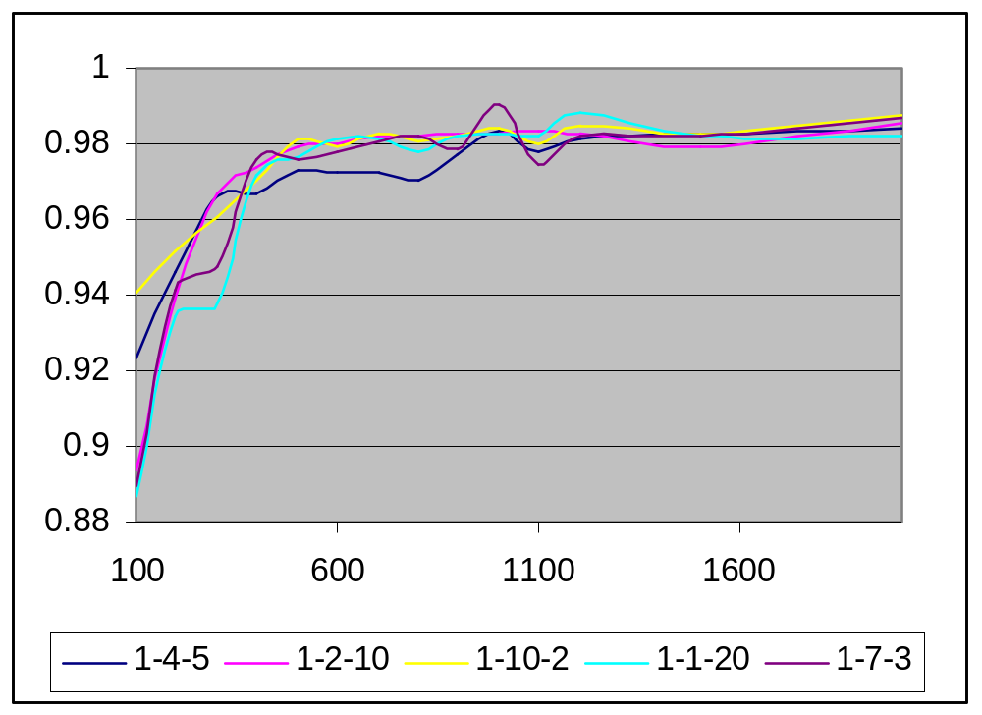
Different Topologies

Slide 27
Parallelization
6 Dell PowerEdge 1850 Servers with 2 Dual Core Xeon processors 2.8GHz memory
Custom socket implementation
1-10-3 topology for solving CBA
Time until the membrane computer reached a solution that was 95% of optimal
Average of 20 trials

Slide 28
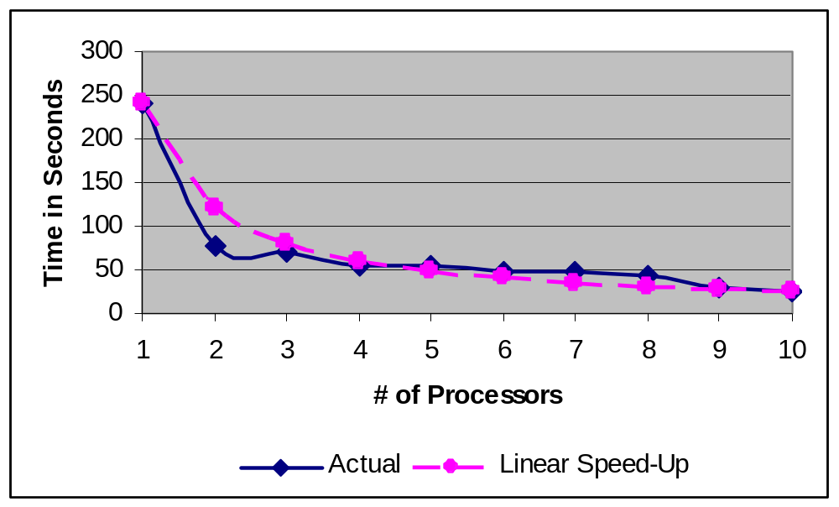
Actual Performance in Solving a CBA Problem

Slide 29
Some Open Questions
Automatic Efficient Parallelization of Membrane Computers
Application to other domains
  Traveling Salesman
  N-queens
  Motif-finding (Bioinformatics)

Slide 30
Thank you!
Your Questions?

